Slide 1
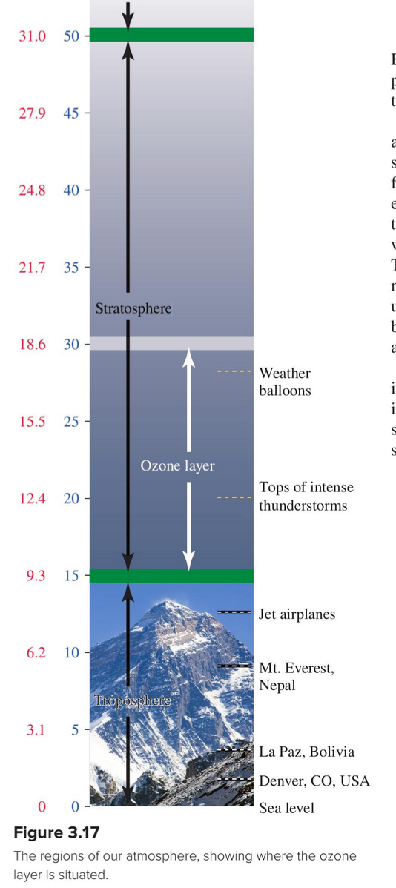
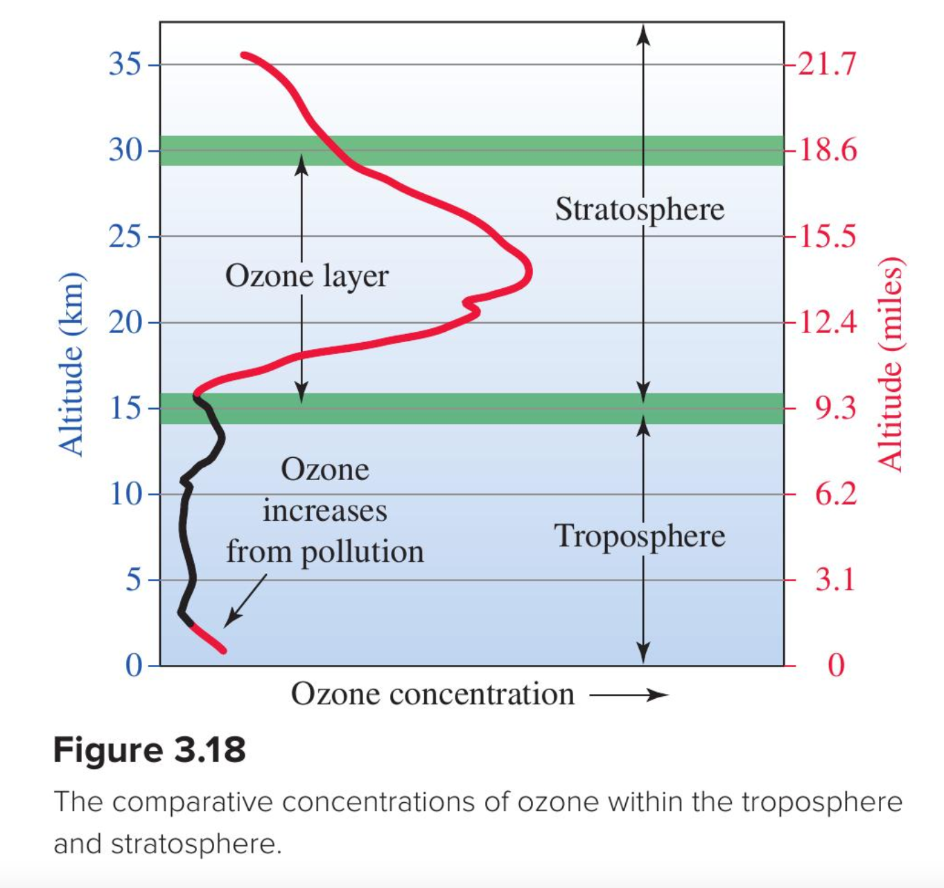
Ozone is mostly found in the stratosphere
Question: Where does stratospheric ozone come from?

Slide 2
Ozone is mostly found in the stratosphere
Question: Where does stratospheric ozone come from?
Answer: From photolysis of O₂!

Slide 3
Ozone is mostly found in the stratosphere
Question: Where does stratospheric ozone come from?
Answer: From photolysis of O₂!
(“-lysis” = “split apart”)

Slide 4
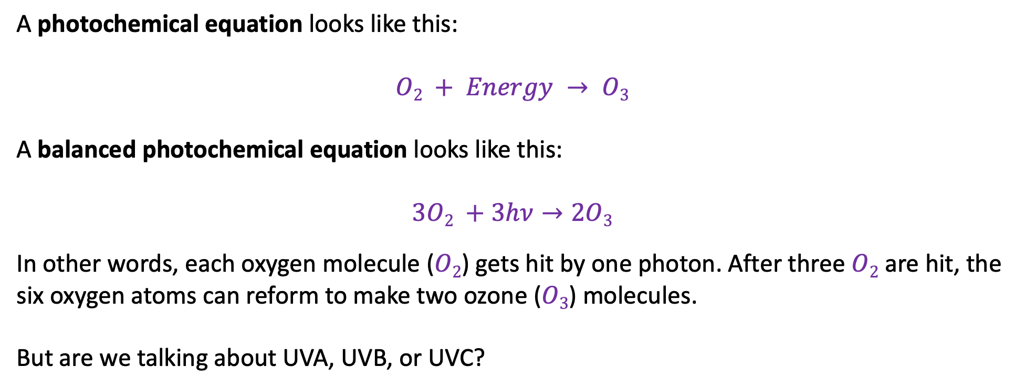
Photochemical equations
A photochemical equation looks like this:
$$O2 + Energy → O3$$
A balanced photochemical equation looks like this:
$$3O2 +3hν→2O3$$
In other words, each oxygen molecule ($O2$) gets hit by one photon. After three $O2$ are hit, the six oxygen atoms can reform to make two ozone ($O3$) molecules.
But are we talking about UVA, UVB, or UVC?

Slide 5
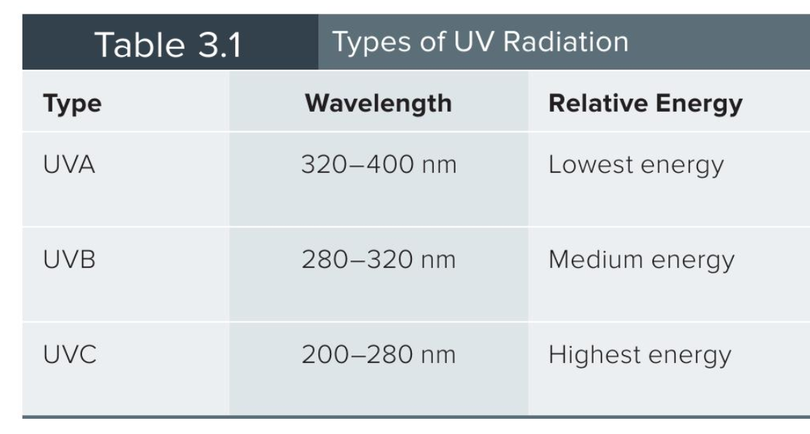
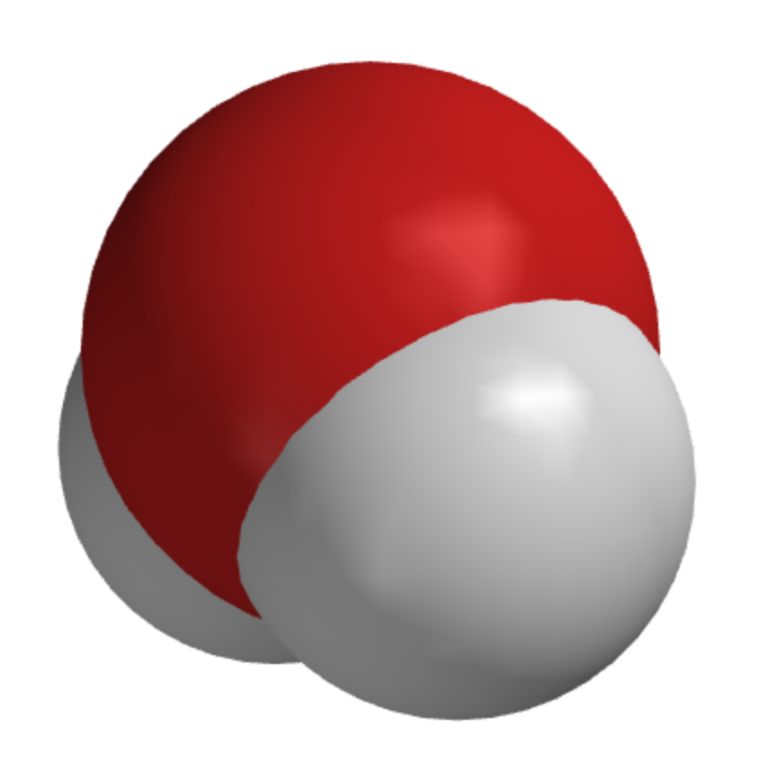
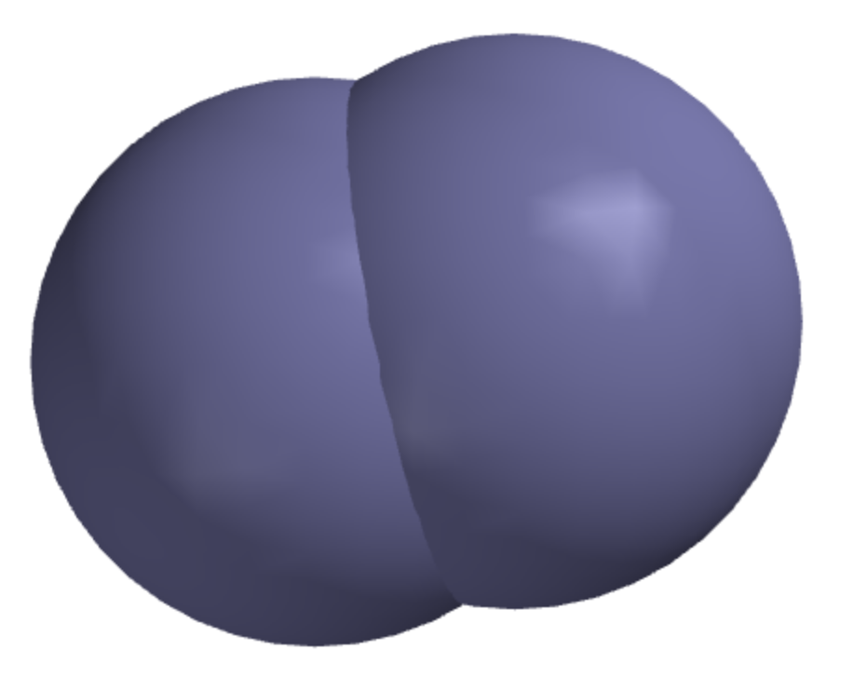
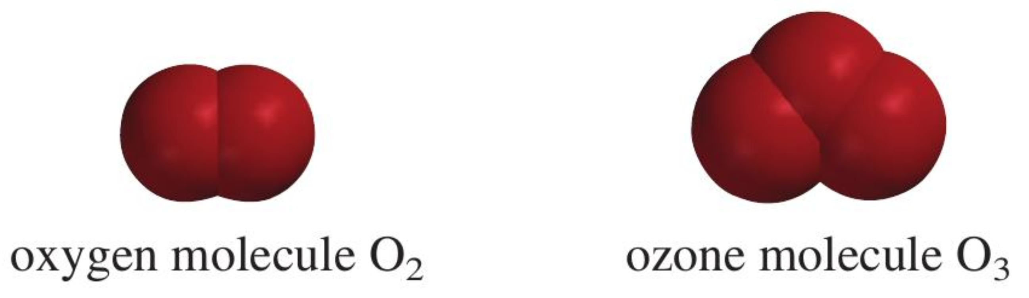
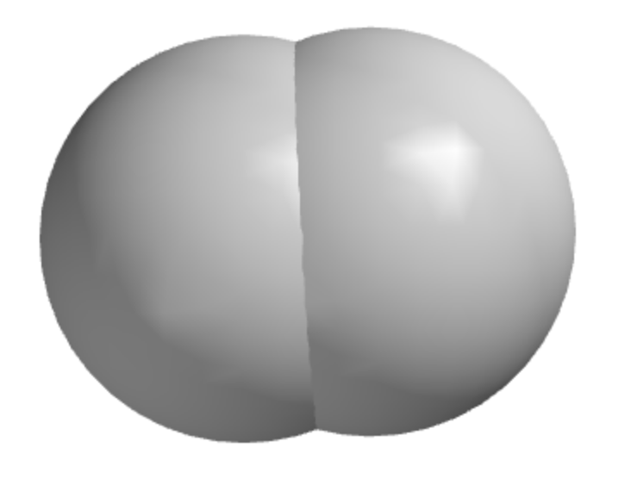
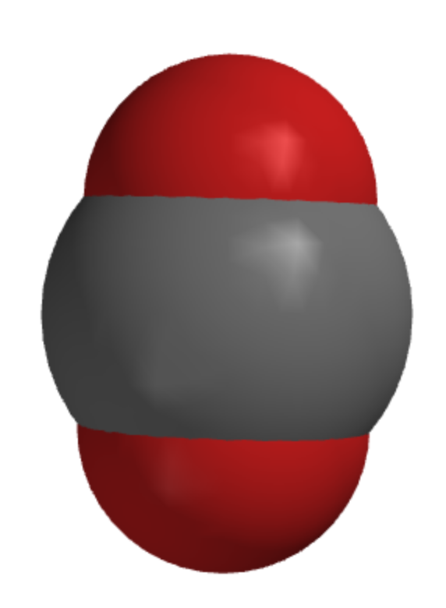
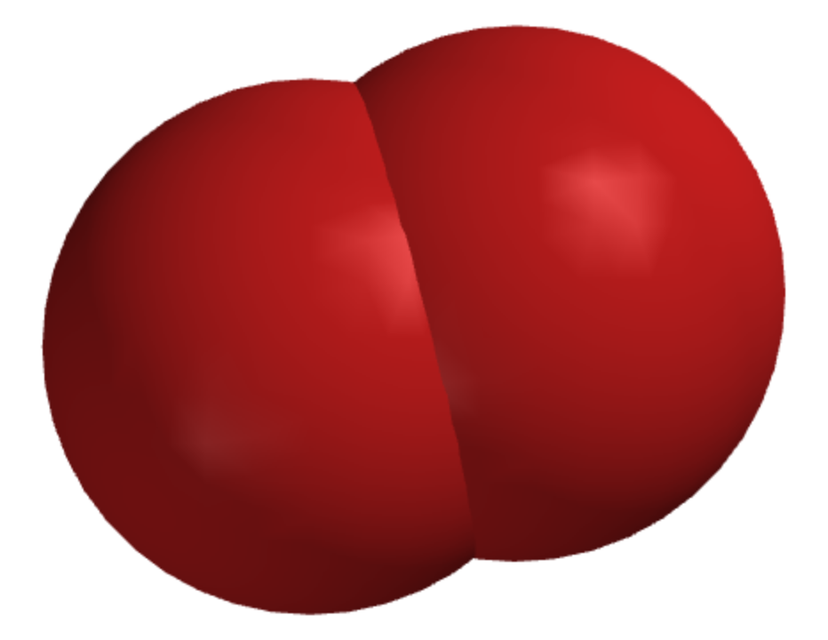
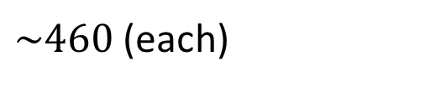
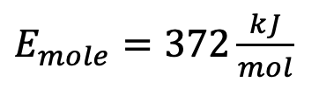
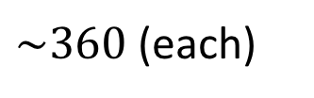

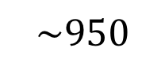
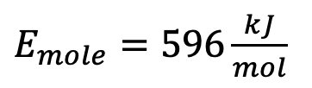
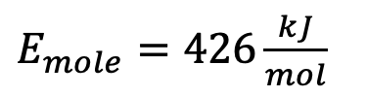
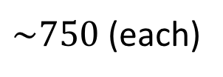
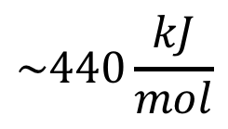
What kind of uv light can break apart O₂ ?
$E_{mole}=372\frac{kJ}{mol}$
$E_{mole}=426\frac{kJ}{mol}$
$E_{mole}=596\frac{kJ}{mol}$
N₂O
$\sim 460$ (each)
$$\sim 950$$
$\sim 360$ (each)
$$\sim 440\frac{kJ}{mol}$$
$\sim 750$(each)
$$\sim 500$$

Slide 6
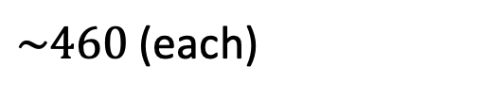
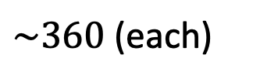
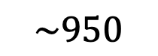
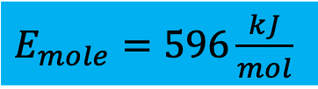
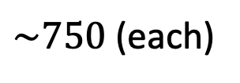
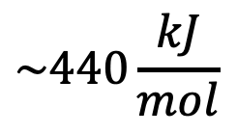
What kind of uv light can break apart O₂ ?
$E_{mole}=372\frac{kJ}{mol}$
$E_{mole}=426\frac{kJ}{mol}$
$E_{mole}=596\frac{kJ}{mol}$
N₂O
$\sim 460$ (each)
$$\sim 950$$
$\sim 360$ (each)
$$\sim 440\frac{kJ}{mol}$$
$\sim 750$(each)
$$\sim 500$$

Slide 7
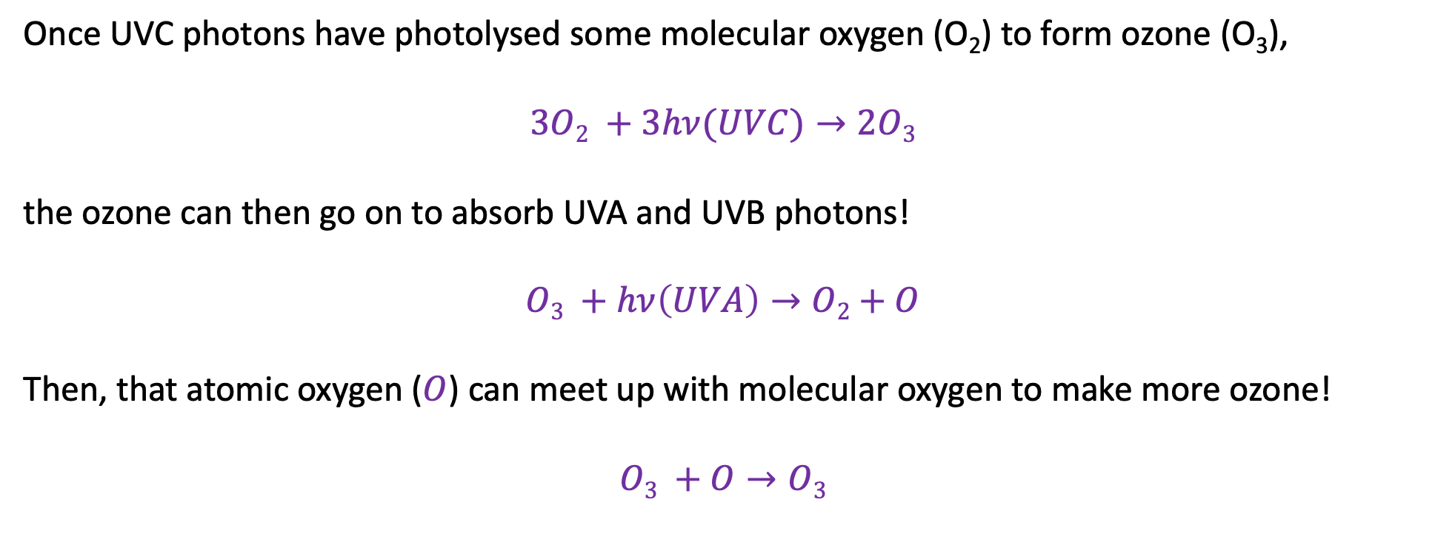
The extra benefit of making ozone
Once UVC photons have photolysed some molecular oxygen (O₂) to form ozone (O₃),
$$3O2 +3hν(UVC)→2O3$$
the ozone can then go on to absorb UVA and UVB photons!
$$O3 +hν\left(UVA\right)→O2+O$$
Then, that atomic oxygen ($O$) can meet up with molecular oxygen to make more ozone!
$$O3 +O→O3$$

Slide 8
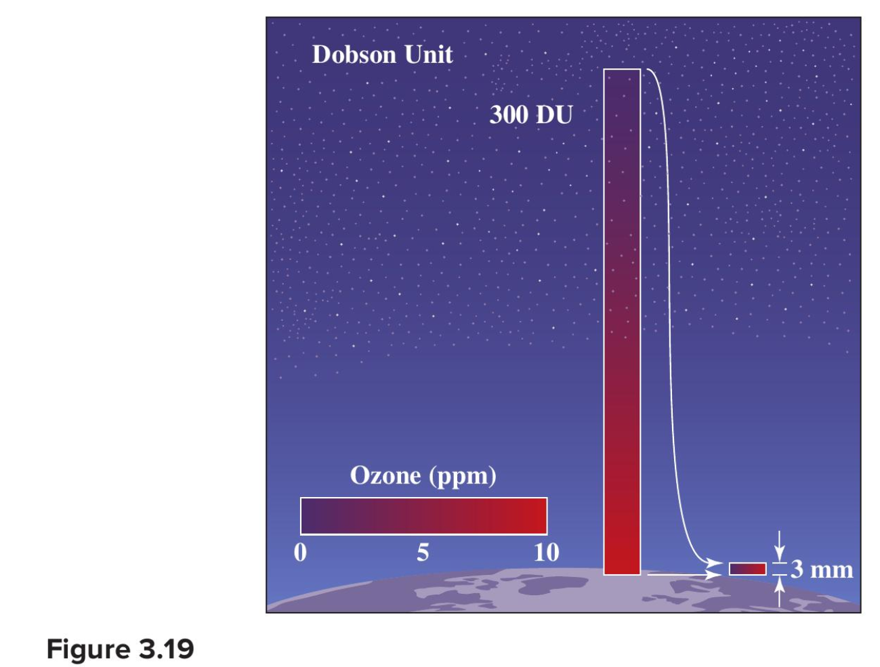
Using Dobson units to indicate the “thickness” of the ozone layer
300 Dobson means pure ozone gas would be a layer 3 mm thick

Slide 9
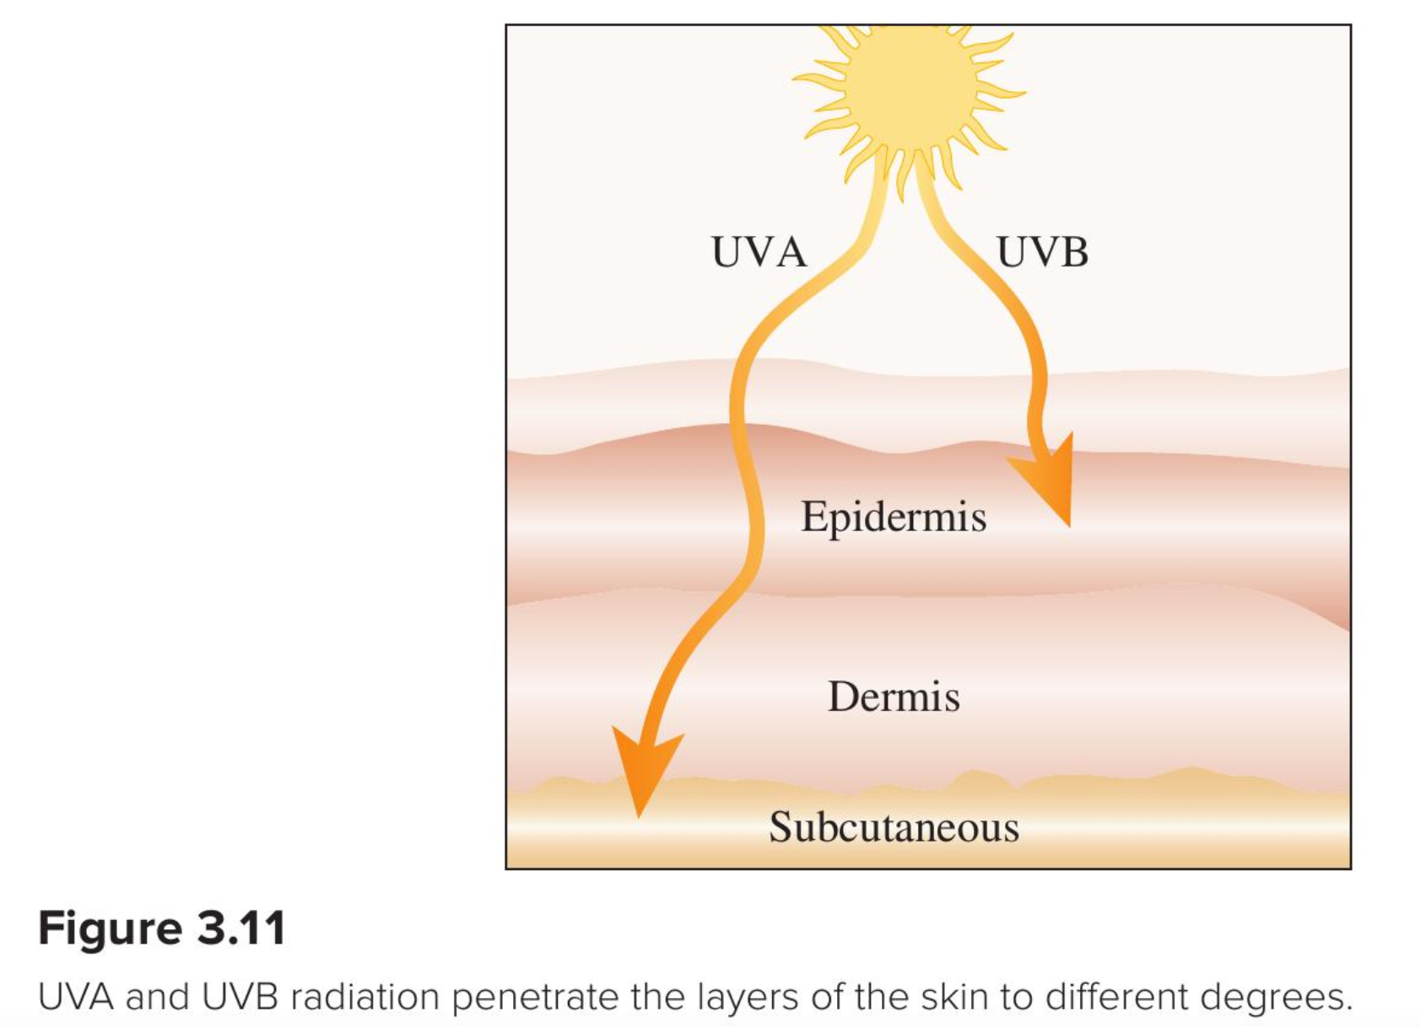

What happens to uv rays that get past the ozone layer?

Slide 10
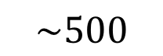
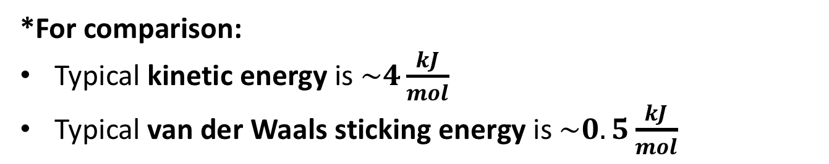
Back to covalent bonds: why are they so strong*?
$\sim 460$ (each)
$$\sim 950$$
$\sim 360$ (each)
$$\sim 440\frac{kJ}{mol}$$
$\sim 750$(each)
$$\sim 500$$
*For comparison:
Typical kinetic energy is $\sim 4\frac{kJ}{mol}$
Typical van der Waals sticking energy is $\sim 0.5\frac{kJ}{mol}$

Slide 11
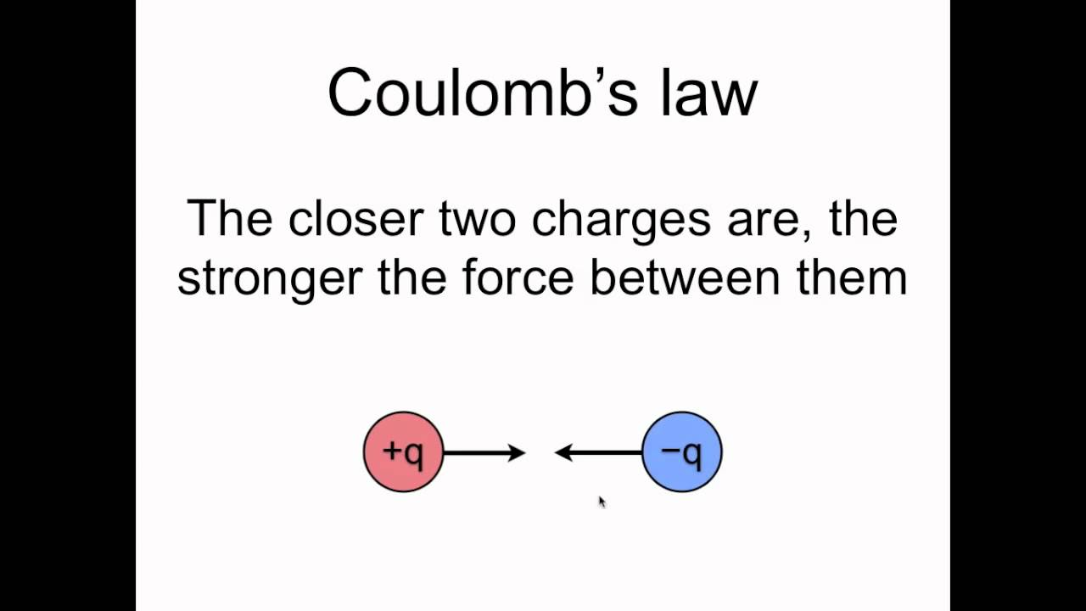
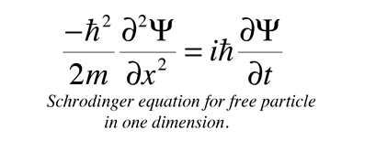
The challenge of understanding covalent bonding
Covalent bonding is hard to understand because it involves a several unfamiliar concepts
Coulomb’s Law – the idea that oppositely-charged particles (like a nucleus and an electron) are attracted to each other, while like charges (like two nuclei or two electrons) are repelled from one another.
Schrödinger’s Equation – a way for us to predict where the electrons on an atom or molecule go.
Fortunately, Spartan has Coulomb’s Law and Schrödinger’s Equation all built in.

Slide 12
Coulomb’s Law – effect of distance
+1
+1
Repelled (pushed apart)
+1
+1
Repelled more when closer

Slide 13
Coulomb’s Law – effect of distance
+1
-1
Attracted (pulled together)
+1
-1
Attracted more when closer

Slide 14
Coulomb’s Law – effect of the magnitude of charge
+1
+1
Repelled (pushed apart)
+2
+1
Repelled more b/c charges are greater (in this case, 2x more force)
+2
+2
Repelled more b/c charges are greater (in this case, 4x more force)

Slide 15
Coulomb’s Law – effect of the magnitude of charge
+1
-1
Attracted (pulled together)
+2
-1
Attracted more b/c charges are greater (in this case, 2x more force)
+2
-2
Attracted more b/c charges are greater (in this case, 4x more force)

Slide 16
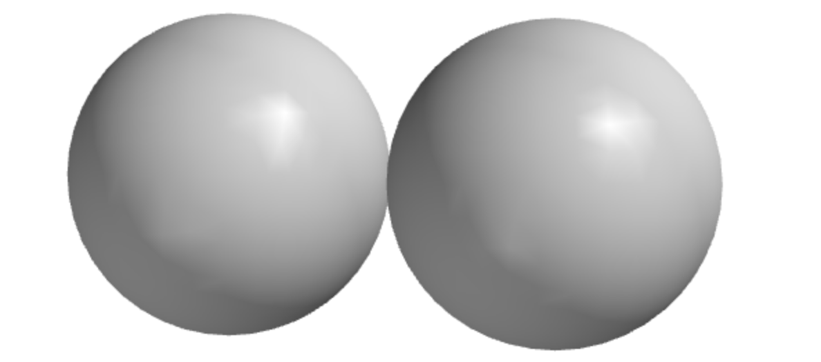
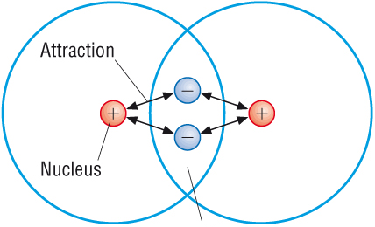
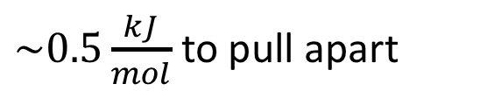
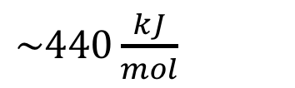
How Coulomb’s Law plays a role in covalent bonding
Here, two hydrogen atoms are at their van der Waals distance – their shells don’t overlap much.
$\sim 0.5\frac{kJ}{mol}$ to pull apart
H
H
H
$\sim 440\frac{kJ}{mol}$
Here, two hydrogen atoms are at their covalent bonding distance –their shells definitely overlap.
H
A consequence of shell overlap: Electrons in the overlap region (like this) are attracted to both nuclei (“cross-Coulombic attraction”). This means it will cost energy to pull them apart:

Slide 17

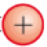
How Coulomb’s Law plays a role in covalent bonding
Here, two hydrogen atoms are at their van der Waals distance – their shells don’t overlap much.
$\sim 0.5\frac{kJ}{mol}$ to pull apart
H
H
H
$\sim 440\frac{kJ}{mol}$
Here, two hydrogen atoms are at their covalent bonding distance –their shells definitely overlap.
H
A consequence of shell overlap: Electrons in the overlap region (like this) are attracted to both nuclei (“cross-Coulombic attraction”). This means it will cost energy to pull them apart:

Slide 18
How Coulomb’s Law plays a role in covalent bonding
Here, two hydrogen atoms are at their van der Waals distance – their shells don’t overlap much.
$\sim 0.5\frac{kJ}{mol}$ to pull apart
H
H
H
$\sim 440\frac{kJ}{mol}$
Here, two hydrogen atoms are at their covalent bonding distance –their shells definitely overlap.
H
A consequence of shell overlap: Electrons in the overlap region (like this) are attracted to both nuclei (“cross-Coulombic attraction”). This means it will cost energy to pull them apart:
Energy needed overcome this cross-Coulombic attraction: $440\frac{kJ}{mol}$

Slide 19
A caveat about this picture … the electron cloud is still a cloud
Slightly more probable position of an electron

Slide 20
A caveat about this picture … the electron cloud is still a cloud
Slightly more probable position of an electron
Possible position of an electron

Slide 21
The number of electrons involved is kept track of by “bond order”
Covalent bonds can be understood as having different bond orders (single, double, or even triple). This is awesome because it lets us make predictions about the strength of the bond.
Bond order = 1, two electrons involved. This is called a single bond.
Bond order = 2, four electrons involved. This is called a double bond. It takes more energy to pull apart double bonds.
(Bond order = 3, six electrons, triple bond, even stronger)

Slide 22
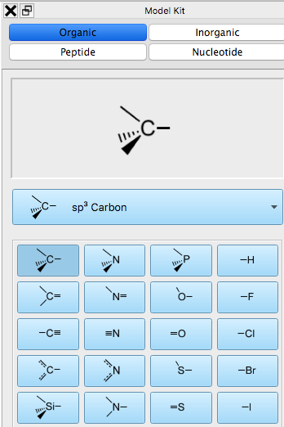
Some examples of different bond orders you’ve seen
H and the halogens (F, Cl, Br, I …) generally make only single bonds.
All other non-metals generally make single, double or triple bonds.

Slide 23
Number of preferred bonds is different for each element
Atoms have distinct preferences as to the number of covalent bonds they make to other atoms
Carbon prefers to make:
Four single bonds
One double and two single bonds
One triple and one single bond
Always four bonds in total

Slide 24
Number of preferred bonds is different for each element
Atoms have distinct preferences as to the number of covalent bonds they make to other atoms
Nitrogen …

Slide 25
Number of preferred bonds is different for each element
Atoms have distinct preferences as to the number of covalent bonds they make to other atoms
Nitrogen
Three single
One double and one single
One triple
Always three bonds in total

Slide 26
Number of preferred bonds is different for each element
Atoms have distinct preferences as to the number of covalent bonds they make to other atoms
Oxygen …

Slide 27
Number of preferred bonds is different for each element
Atoms have distinct preferences as to the number of covalent bonds they make to other atoms
Oxygen
Two single
One double
Always two bonds in total

Slide 28
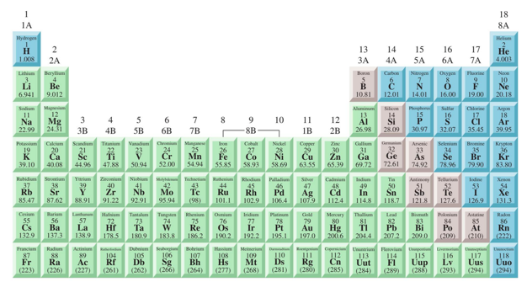
Patterns of covalent bonding
Comparing Spartan to the Periodic Table, identify a correlation between the family (column) and the total number of bonds made (non-metals only).

Slide 29
Patterns of covalent bonding
Comparing Spartan to the Periodic Table, identify a correlation between the family (column) and the total number of bonds made (non-metals only).
1
4
3
2
1

Slide 30
Patterns of covalent bonding
Comparing Spartan to the Periodic Table, identify a correlation between the family (column) and the total number of bonds made (non-metals only).
1
3
4
3
2
1
0

Slide 31
What we can do with these patterns
Predict the connectivity and bond order in the following molecules
CH₄
C₂H₆
C₂H₄
C₂H₂
SiH₄
NH₃
N₂
CO₂
Cl₂
HNO
HNS
NOCl
PF₃
HCN
H₂O
H₂S
H₂CO
CH₃F
CH₃Cl
HONO
O₂

Slide 32
What we can do with these patterns
Predict the connectivity and bond order in the following molecules
CH₄
CO₂
Connectivity can’t be H-H-H-C b/c …

Slide 33
What we can do with these patterns
Predict the connectivity and bond order in the following molecules
CH₄
CO₂
Connectivity can’t be H-H-H-C b/c H makes only one bond

Slide 34
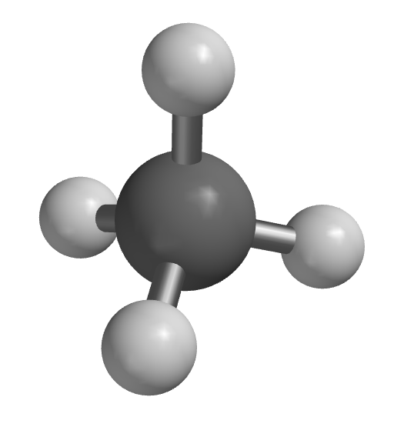
What we can do with these patterns
Predict the connectivity and bond order in the following molecules
CH₄
CO₂
Connectivity can’t be H-H-H-C b/c H makes only one bond
H
H
C
H
H
(all single covalent bonds)

Slide 35
What we can do with these patterns
Predict the connectivity and bond order in the following molecules
CH₄
CO₂
Connectivity can’t be H-H-H-C b/c H makes only one bond
Possible connectivity:
C-O-O
O-C-O
Which works in terms of bonds?
H
H
C
H
H
(all single covalent bonds)

